Slide 1

Leather Belt Manufacturing Process

Slide 2
Leather FASION Belts
Manufacturing steps and cost calculation project

Slide 3
Steps in the Manufacturing Process
Step | Description | Details
1 | Provide sizes and complete order sheets | Online form to complete
2 | Roll out saddle skirting | I will do this step prior & provide info
3 | Square off the side | I will do this step prior & provide info
4 | Strip out 1.5" leather straps | I will do this step prior & provide info
4A | Cut straps to rough length | I will do this step prior & provide info
5 | Cut and punch holes for strap buckle end | I will do this step prior & provide info
6 | Trim the tip to length with custom cutting die & punch holes | We will do this in lecture with your sizing
7 | Bevel the edges | I will do this step prior & provide info
8 | Hand sand the edges | Homework assignment using kit
9 | Saddle soap the edges | Homework assignment using kit
10 | Mount the buckle & loop | Homework assignment using kit
11 | Press the maker stamp into the leather | We will do this in lecture
12 | Roller embossing | We will do this in lecture
13 | Package belt & deliver | We will do this in lecture
14 | Sewing | We will do this in lecture
15 | Tear down, Clean up and Reset | I will do this step & provide info

Slide 4
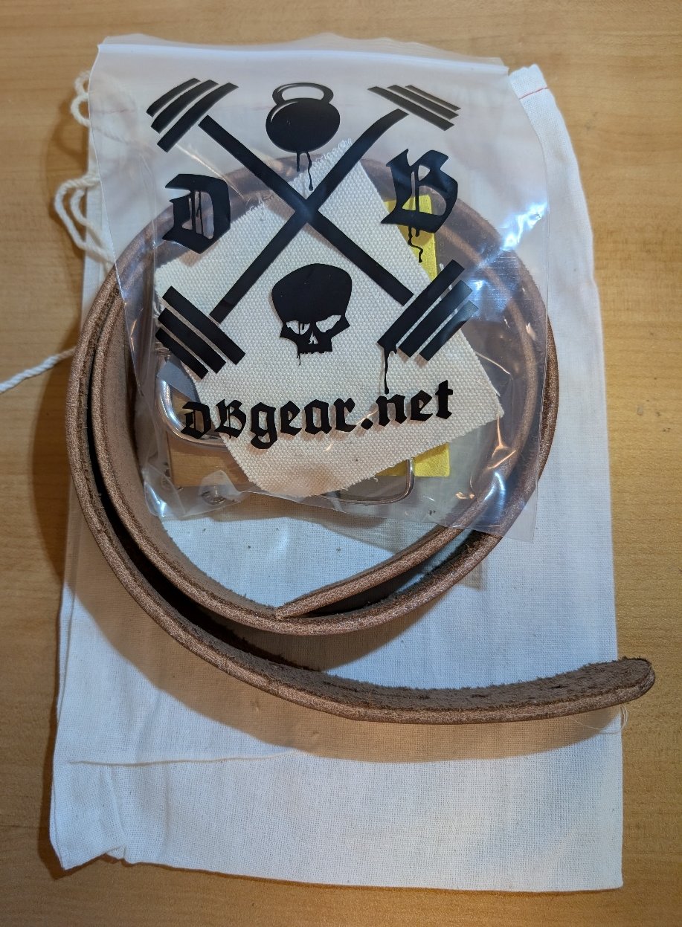
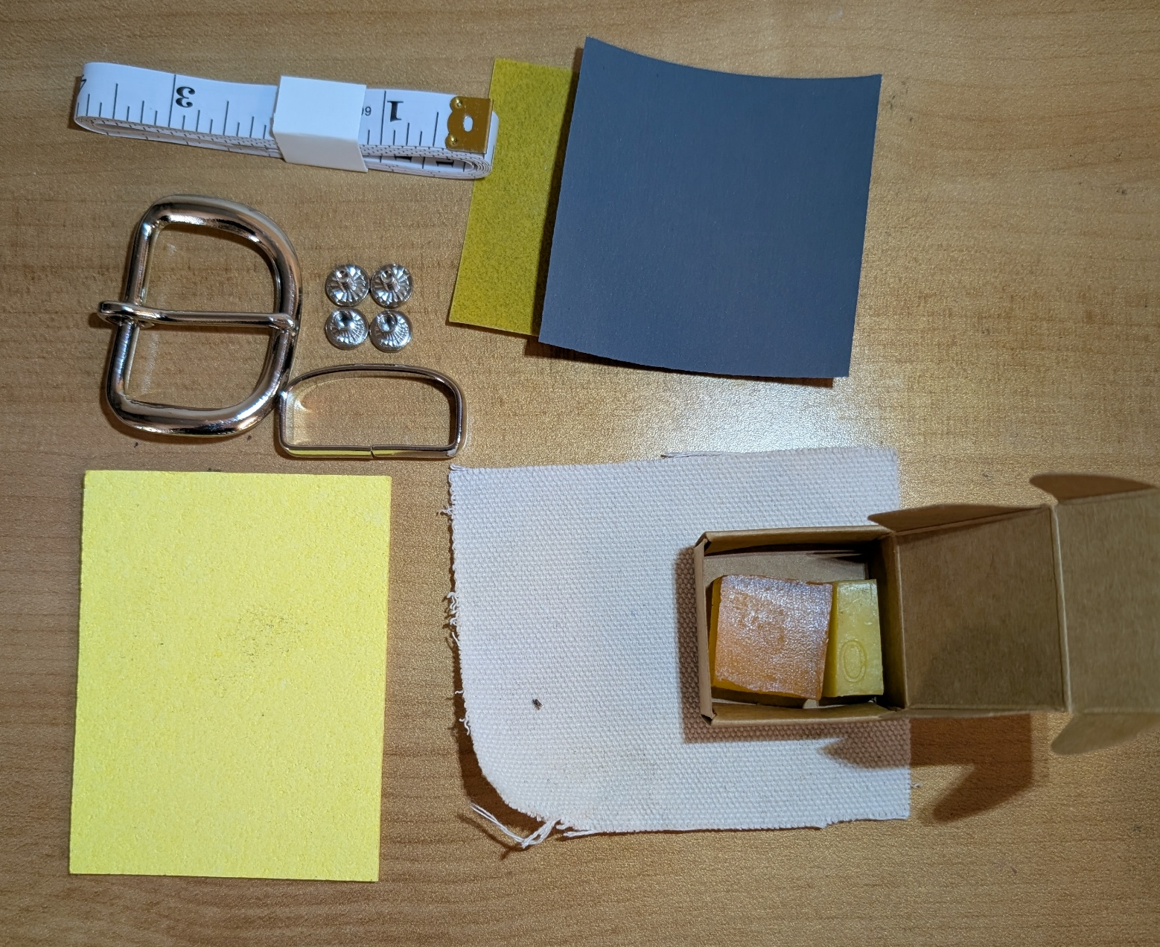
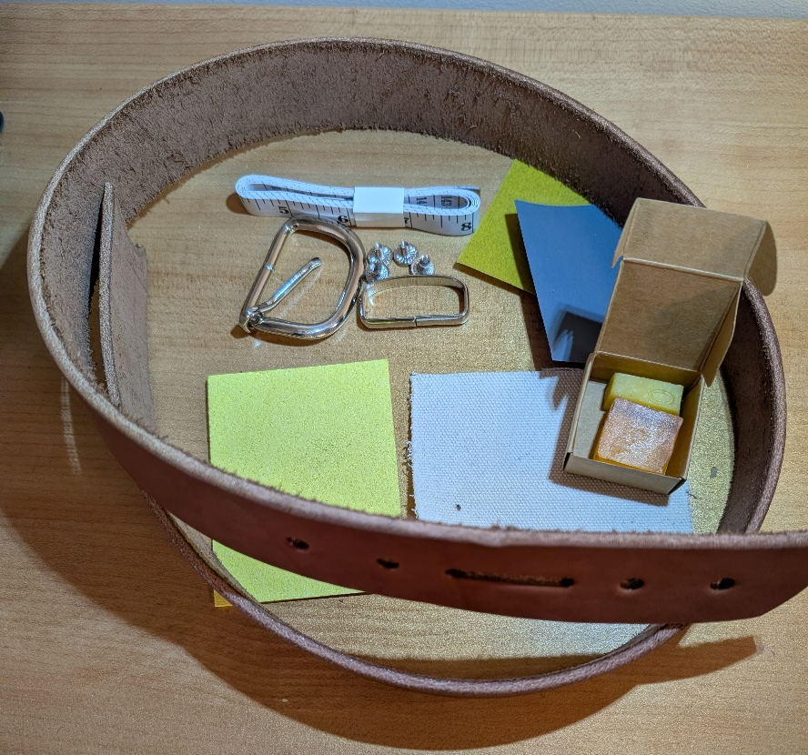
Take home Kits
CONTENTS:
Tote bag
Belt blank (1.5” wide, Beveled with buckle end punched)
Tape measure
Sponge
Sandpaper
  400 grit
  3000 grit
Canvas cloth
Saddle Soap
Bees wax
Buckle
Loop
Chicago screws

Slide 5
Step 1
fill out order sheet to give to the manufacturing facility

Slide 6
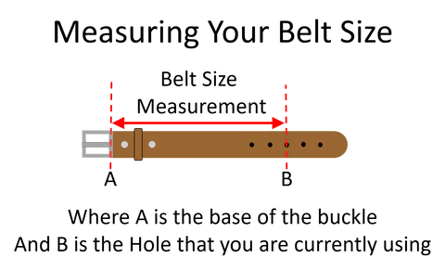
Sizing Measurement Instructions

Slide 7
Name | Belt Size (A-B Length) | Tip to Tip length (+ 9.5”) | Leather Color | Makers stamp | Roller embossed
Dr. Burns | 36” | 45.5” | Brown | Custom made | NO
John Smith | 32” | 41.5” | Brown | NO | Floral
Create an order sheet or an order form online for students to select options and sizing

Slide 8
Step 2
ROLL OUT
SADDLE SKIRTING

Slide 9
Step 2:
ROLL OUT SADDLE SKIRTING
Materials:
10-12 of Saddle skirting Purchases from tannery at $300 per side
~88% yield (What is the scrap rate?)
  How could we reuse / recycle this scrap?
Equipment:
Box knife to open box ($20)
Tools:
Knife blade for box knife ($25 for a box of 100)
Supplies:
Are any supplies used?
Time: (Which of these are time per piece and which is a time for the entire batch?)
Open the box?
How long does it take to roll out the leather?
Break down box?
Anything else?

Slide 10
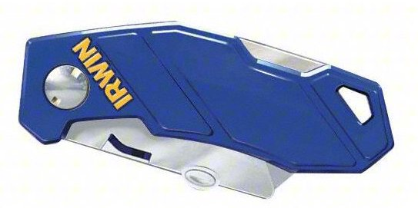
IRWIN Folding Utility Knife
https://www.grainger.com/product/4A805?gucid=N:N:PS:Paid:GGL:CSM-2293:8FEML8:20800606:APZ_1&gclsrc=aw.ds&gad_source=1&gad_campaignid=22472343323&gclid=CjwKCAiAkvDMBhBMEiwAnUA9BVKWrHAys84nDXbCdi8imdBCJjzBwBPHKE0sMIBm6v-tAuRPixi-WBoC7REQAvD_BwE

Slide 11
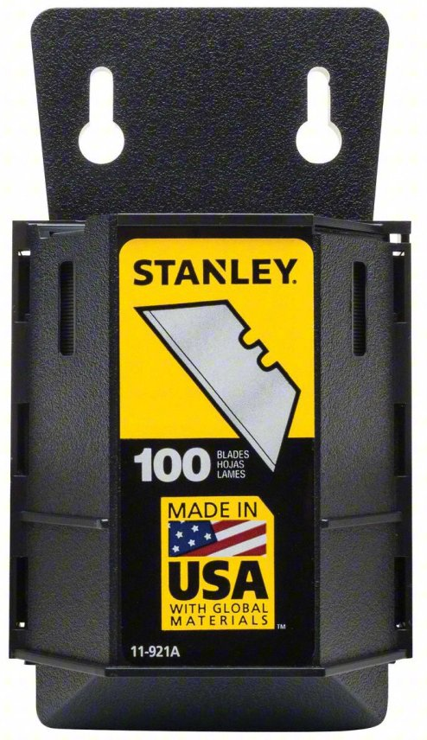
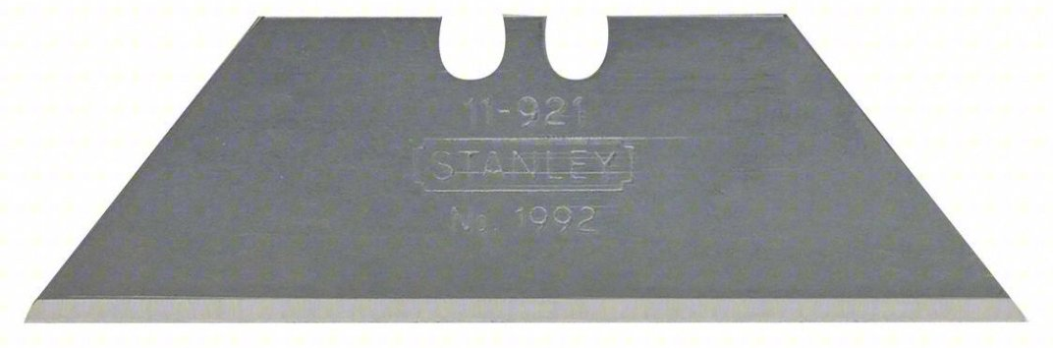
STANLEY Utility Blade: 2 7/16 in Blade Lg, 3/4 in Blade Wd, 0.024 in Blade Thick, Steel, 100 PK
https://www.grainger.com/product/4A805?gucid=N:N:PS:Paid:GGL:CSM-2293:8FEML8:20800606:APZ_1&gclsrc=aw.ds&gad_source=1&gad_campaignid=22472343323&gclid=CjwKCAiAkvDMBhBMEiwAnUA9BVKWrHAys84nDXbCdi8imdBCJjzBwBPHKE0sMIBm6v-tAuRPixi-WBoC7REQAvD_BwE

Slide 12
Step 3
SQUARE OFF the SIDE

Slide 13
Step 3:
SQUARE OFF the SIDE
Materials:
10-12 of Saddle skirting Purchases from tannery at $300 per side (Already counted in step2?)
Equipment:
Table (8’ long by 4’ wide)
HDPE plastic table protector $90 (~1000 uses)
Mondo Trimmer (102”) $300 {https://uscutter.com/Mondo-Trimmer}
Tools:
Cutting blade for Mondo Trimmer ($25 for a box of 100)
Supplies:
Are any supplies used?
Time: (What is per piece and what is for the entire batch?)
Setup the trimmer
How long does it take to replace the blade?
  How often do you need to replace the blade?
    Once per batch?
Dispose of extra scrap leather
Anything else?

Slide 14
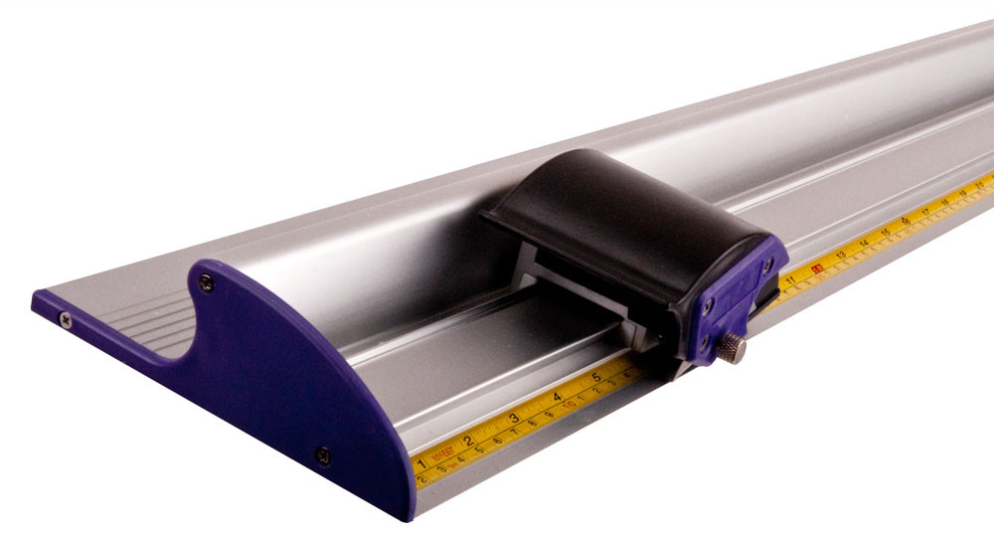
Mondo Trimmer, Vinyl, Banner, Cardboard and Other Material Trimmer
USCutter
SKU: TUMONTRIM102
https://uscutter.com/Mondo-Trimmer/

Slide 15
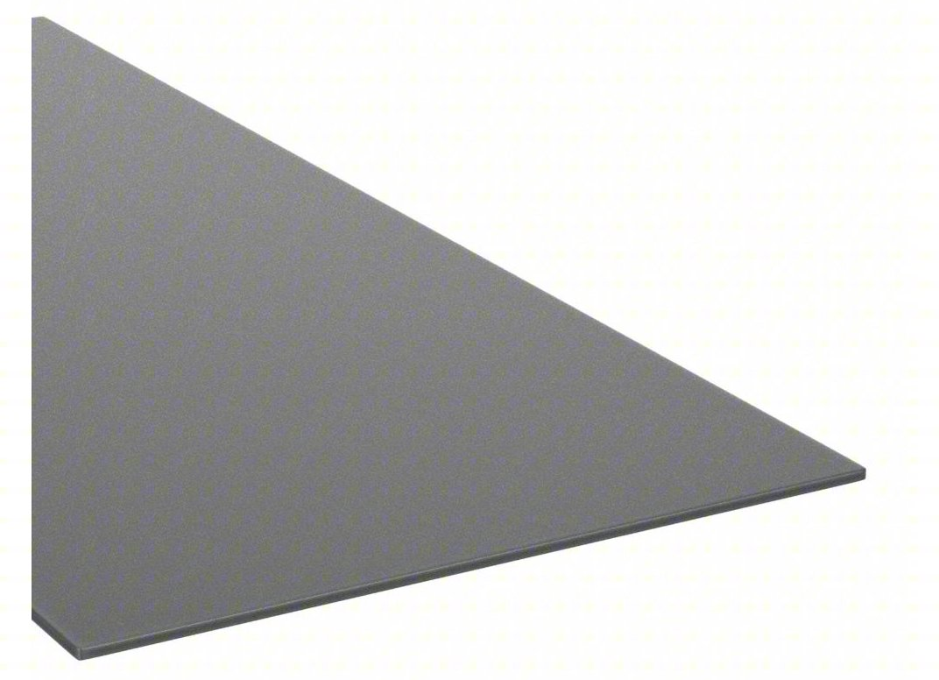
HDPE Sheet: 0.0625 in Thick, 4 ft x 8 ft, Opaque, 4,600 psi Tensile Strength
https://www.grainger.com/category/raw-materials/plastics/plastic-sheets-bars/general-purpose-plastic-sheets-bars/high-strength-moisture-resistant-hdpe-sheets-bars?attrs=Plastic+Length%7C8+ft~~Plastic+Width%7C4+ft&filters=attrs%2CwebParentSkuKey&webParentSkuKey=WP12601741

Slide 16
STANLEY Utility Blade: 2 7/16 in Blade Lg, 3/4 in Blade Wd, 0.024 in Blade Thick, Steel, 100 PK
https://www.grainger.com/product/4A805?gucid=N:N:PS:Paid:GGL:CSM-2293:8FEML8:20800606:APZ_1&gclsrc=aw.ds&gad_source=1&gad_campaignid=22472343323&gclid=CjwKCAiAkvDMBhBMEiwAnUA9BVKWrHAys84nDXbCdi8imdBCJjzBwBPHKE0sMIBm6v-tAuRPixi-WBoC7REQAvD_BwE

Slide 17
Step 4
STRIP OUT 1.5" LEATHER STRAPS

Slide 18
Step 4:
STRIP OUT 1.5" STRAPS
Materials:
10-12 of Saddle skirting Purchases from tannery at $300 per side (Did you count this already in a previous step?)
Equipment:
Craftool® Strap Cutter $40
Tools:
Replacement Blades 5 Pack ($5 for a box of 5)
Supplies:
Are any supplies used?
Time: (What is per piece and what is for the entire batch?)
Setup the strap cutter to the correct width
How long does it take to replace the blade?
  How often do you need to replace the blade?
    Once per batch?
Roll up an store straps that are cut?
Anything else?

Slide 19
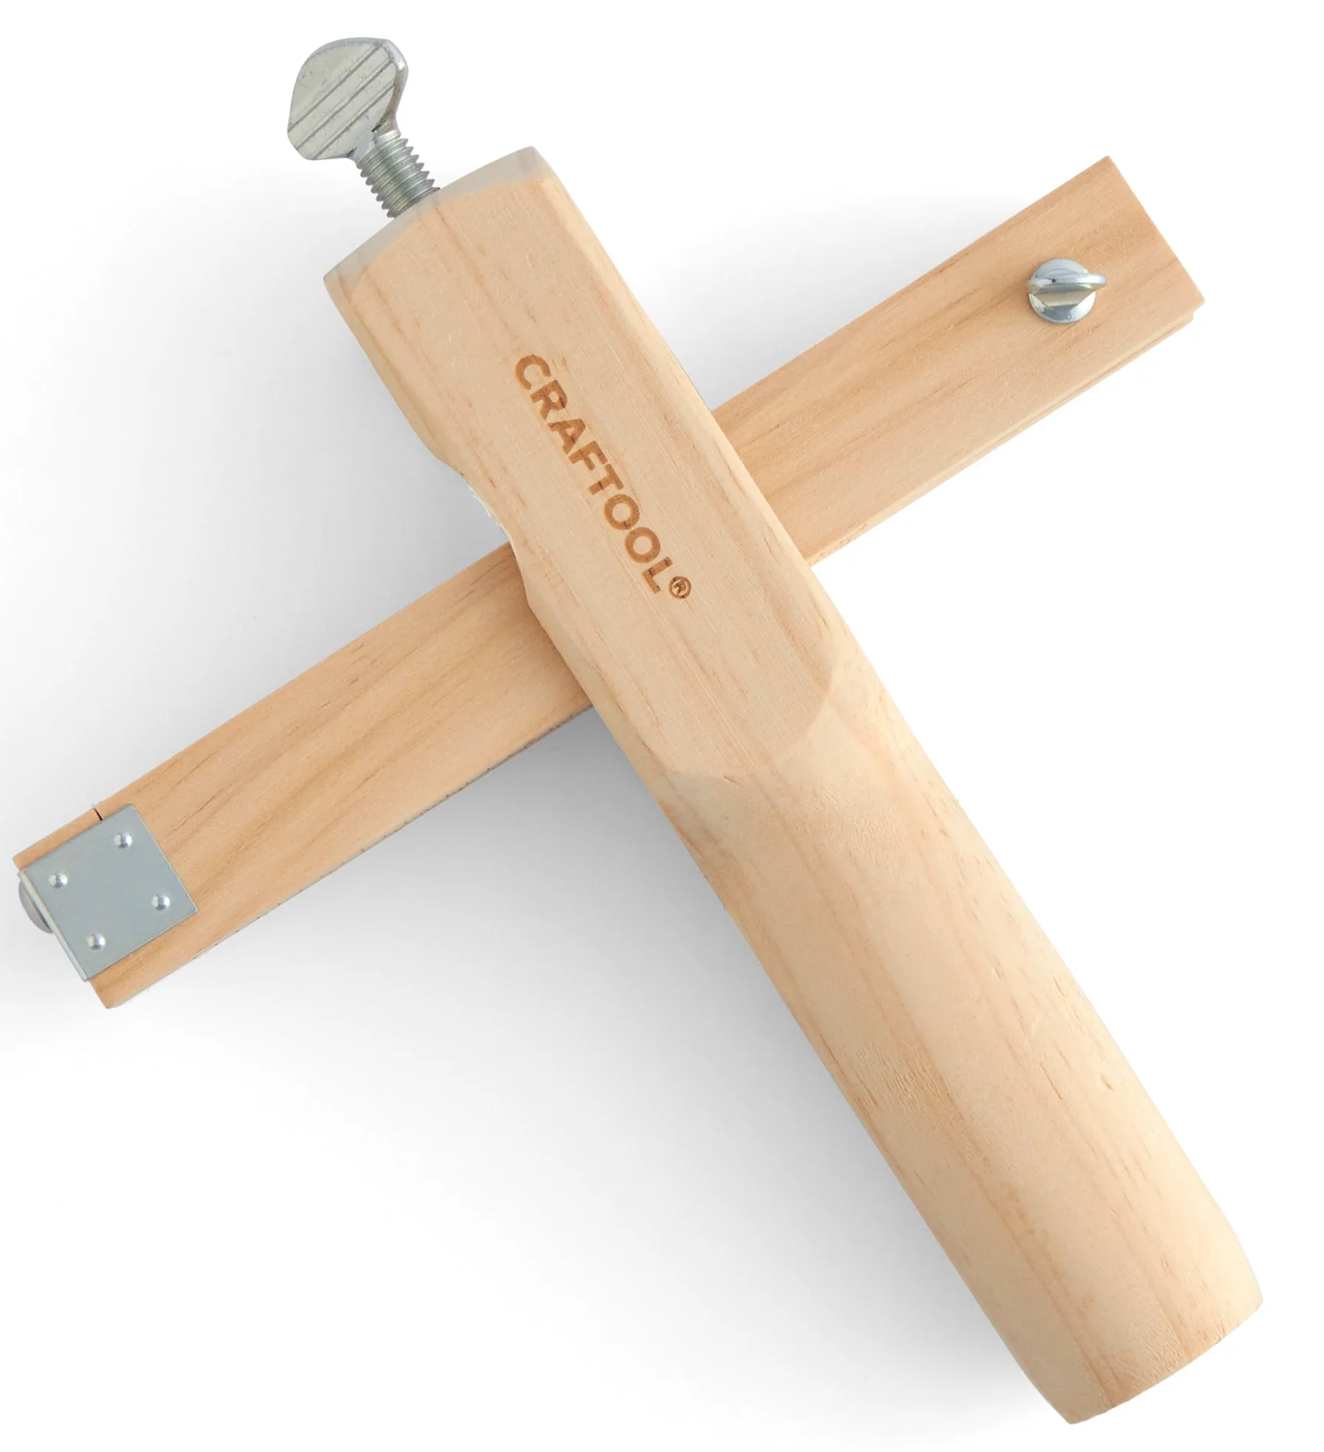
Craftool® Strap Cutter
https://tandyleather.com/products/craftool-strap-cutter?variant=45233556488323

Slide 20
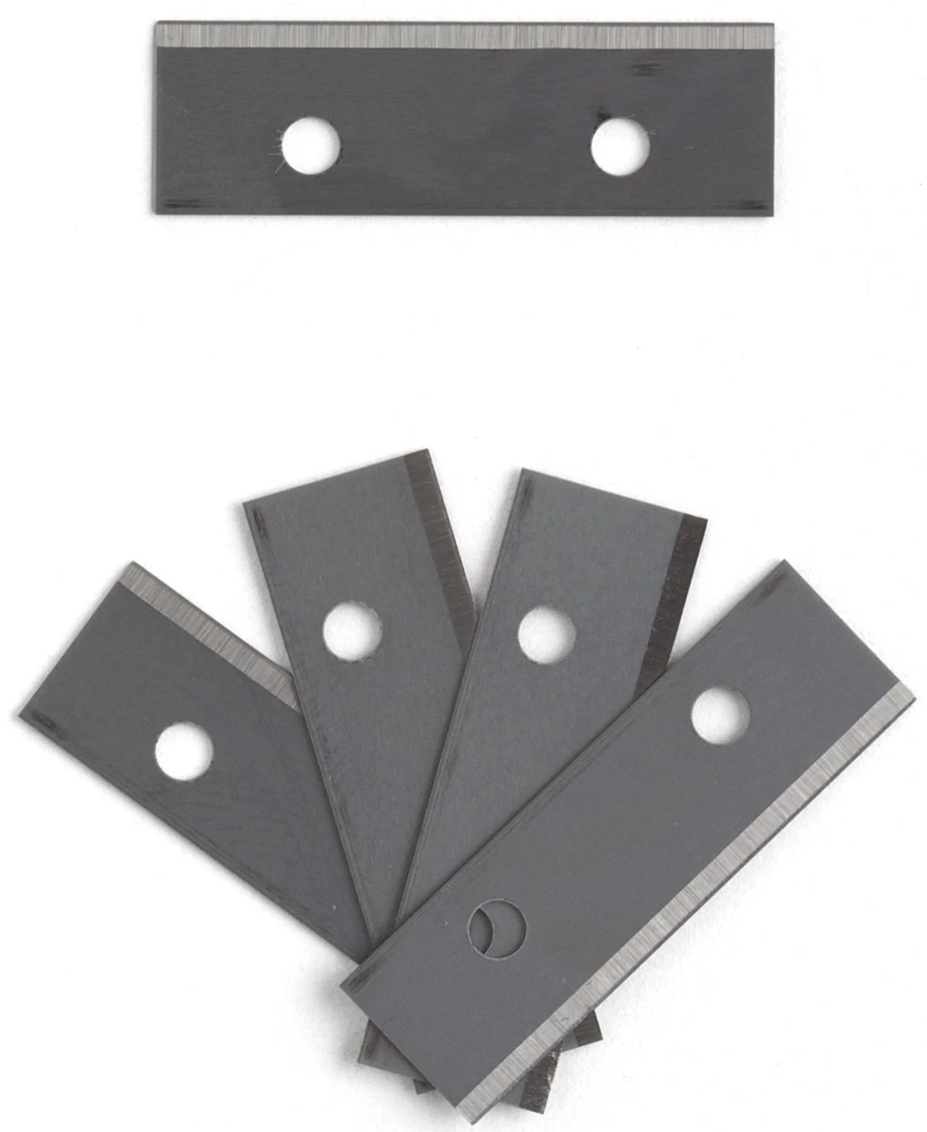
Strap Cutter Replacement Blades 5 Pack
https://tandyleather.com/products/replacement-blades-5-pack?_pos=2&_psq=Strap+Cutter+bla&_ss=e&_v=1.0

Slide 21
Step 4a
CUT STRAPS TO LENGTH

Slide 22
Step 4A:
Cut STRAPS to rough length
Is this step necessary?
Materials:
No new material
  With this trimming should we think about recalculating our scrap rate?
Equipment:
Stohlman Brand® Round Knife $90
Tools:
Sharpen blade every 1000 belts
Supplies:
Are any supplies used?
Time: (What is per piece and what is for the entire batch?)
Setup time to lay out the strap
Time to cut each strap to length
Time to dispose of scrap
  Could this be used for something else?
Anything else?

Slide 23
Step 5
Cut and punch holes for strap buckle end

Slide 24
Step 5:
Cut and punch holes for strap buckle end
Materials:
No new material
Equipment:
Craftplus® Tipping Machine ($1000)
Tools:
The cost of the cutting dies were included in the cost of the Craftplus® Tipping Machine
Supplies:
Are any supplies used?
Time: (What is per piece and what is for the entire batch?)
Setup time to get the end cutting die on the tipping machine and set to the desired width
Time to cut each strap end
Time to dispose of scrap
  Could this be used for something else?
Anything else?

Slide 25
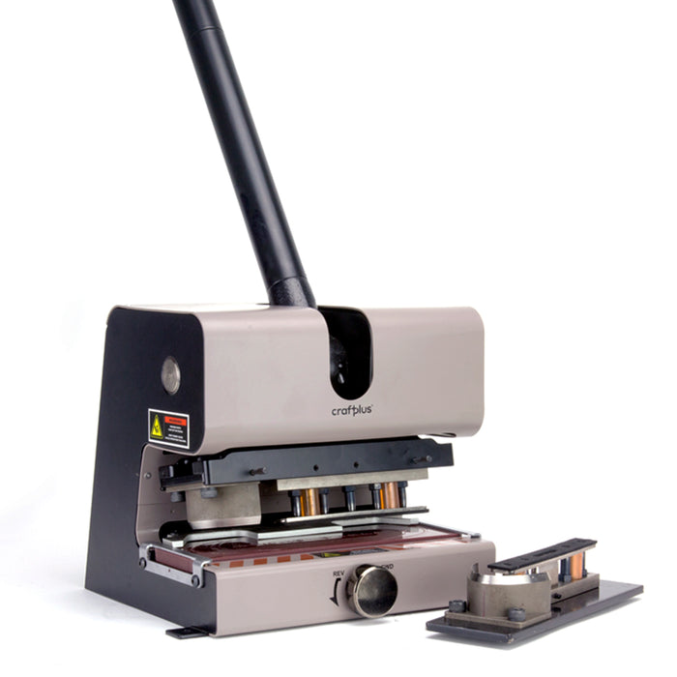
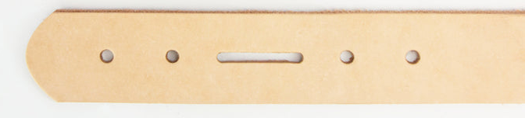
Craftplus® Tipping Machine
https://www.ivan.tw/products/craftplus-tipping-machine?srsltid=AfmBOopuMo7lsD34xrzR-9SOlOm-fPtuogK6HnfCjKJLLphHQXH8chrV

Slide 26
Step 6
TRIM THE tip TO LENGTH with custom cutting die & punch holes

Slide 27
Step 6:
TRIM tip TO LENGTH
Materials:
No new material
Equipment:
No new equipment used in this step
Tools:
The cost of the cutting dies were included in the cost of the Craftplus® Tipping Machine
Supplies:
Are any supplies used?
Time: (What is per piece and what is for the entire batch?)
Setup time to switch the cutting die on the tipping machine and check that the desired width is still correct
Time to cut each strap tip
Time to dispose of scrap
  Could this be used for something else?
Anything else?

Slide 28
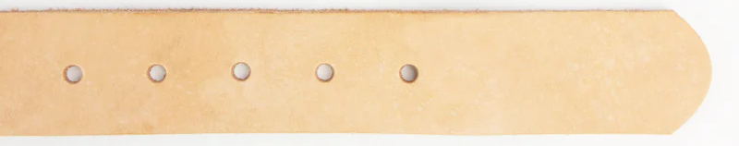
Craftplus® Tipping Machine
https://www.ivan.tw/products/craftplus-tipping-machine?srsltid=AfmBOopuMo7lsD34xrzR-9SOlOm-fPtuogK6HnfCjKJLLphHQXH8chrV

Slide 29
Step 7
BEVEL THE EDGES

Slide 30
Step 7:
BEVEL THE EDGES
Materials:
No new material
Equipment:
Master Tool EZ Edge Strap Beveler $380
Tools:
The cost of the blades were included in the cost of the Master Tool EZ Edge Strap Beveler
  Need to be replaced every 1000 belts $110
Supplies:
Are any supplies used?
Time: (What is per piece and what is for the entire batch?)
Setup time to switch the cutting die on the tipping machine and check that the desired width is still correct
Time to cut each strap tip
Time to dispose of scrap
  Could this be used for something else?
Anything else?

Slide 31
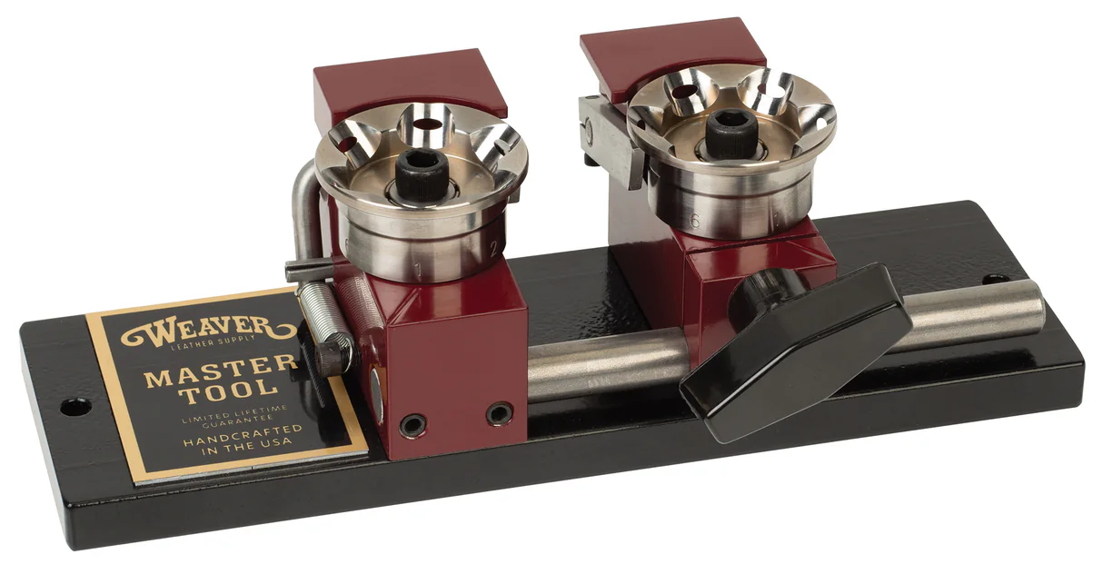
Master Tool EZ Edge Strap Beveler
https://www.weaverleathersupply.com/products/master-tool-ez-edge-strap-beveler

Slide 32
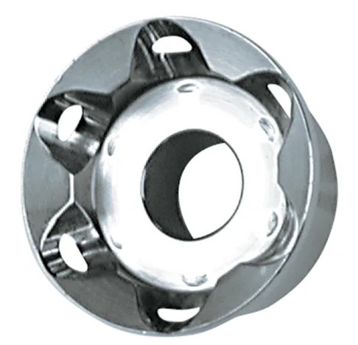
Replacement Blades for EZ Edge Strap Beveler
https://www.weaverleathersupply.com/products/replacement-blades-for-ez-edge-strap-beveler?variant=40909331136652

Slide 33
Step 8
HAND SAND THE EDGES

Slide 34
Step 8:
HAND SAND THE EDGES
Materials:
Sandpaper
  400 grit ($10 for 12 sheets) 1 sheet can do 10 belts
  3000 grit ($9 for 5 sheets) 1 sheet can do 10 belts
Equipment:
None (Is there any equipment that could be used to save labor time in the process?)
Tools:
None
Supplies:
Sponges ($10 for 12 sponges) 1 sponge can do 50 belts
Tupperware bines for sponges and water ($22 for 6)
Scissors ($6 per pair)
Time:
Setup time to fill water, get supplies together and set up the workstation
Time to wet edges and sand with 400 grit
Time to wet edges and sand with 3000 grit
Time to inspect and check your work

Slide 35
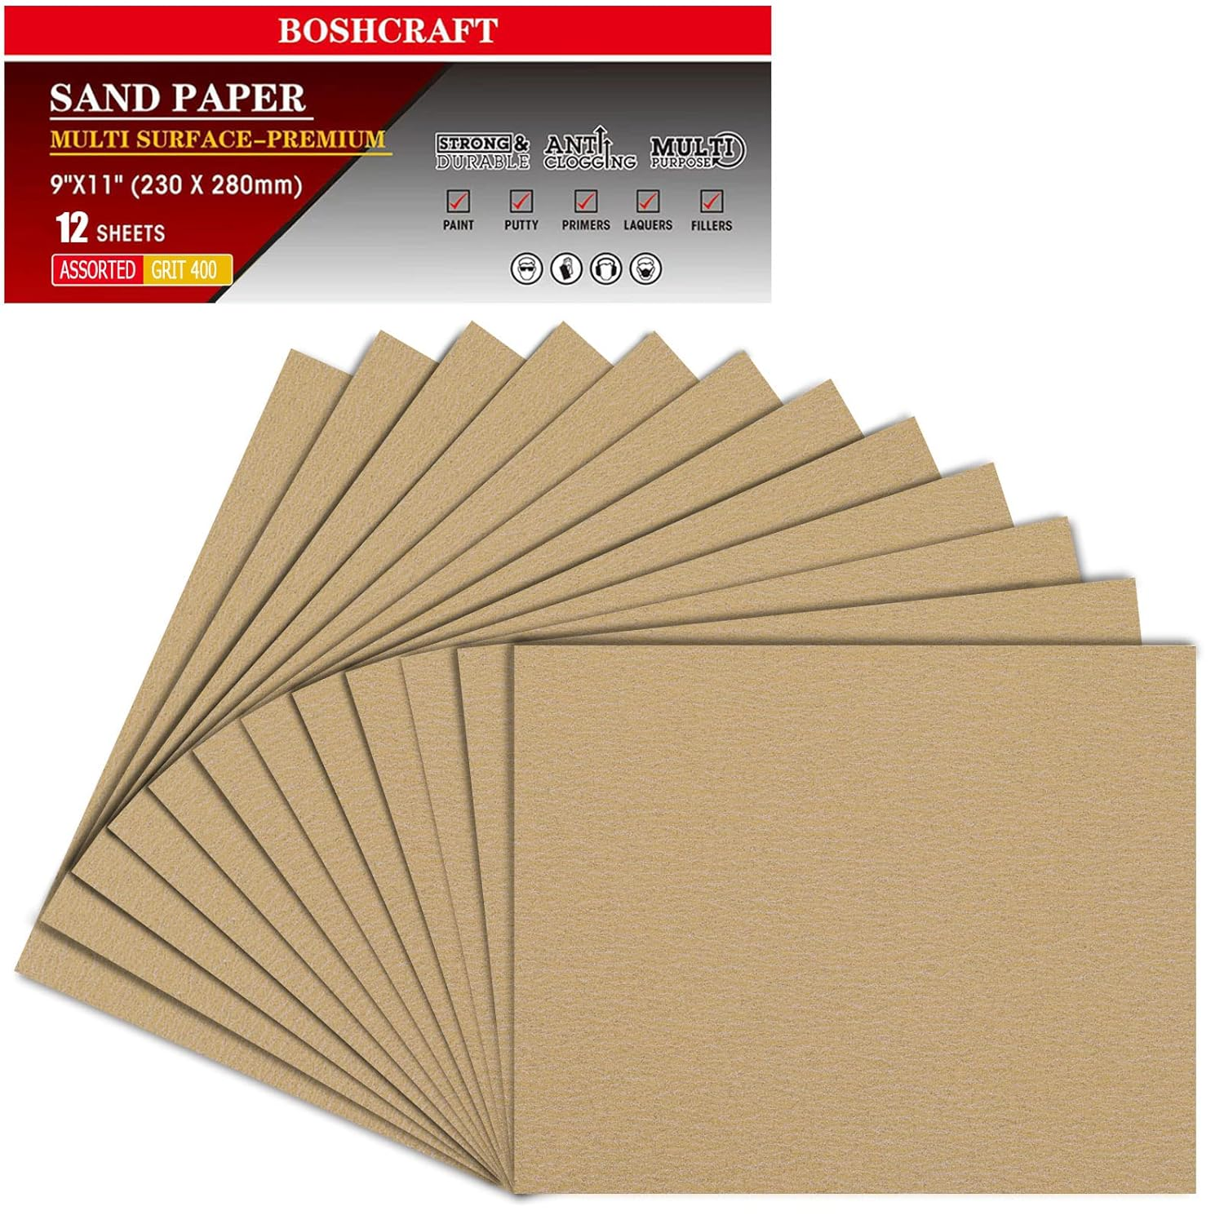
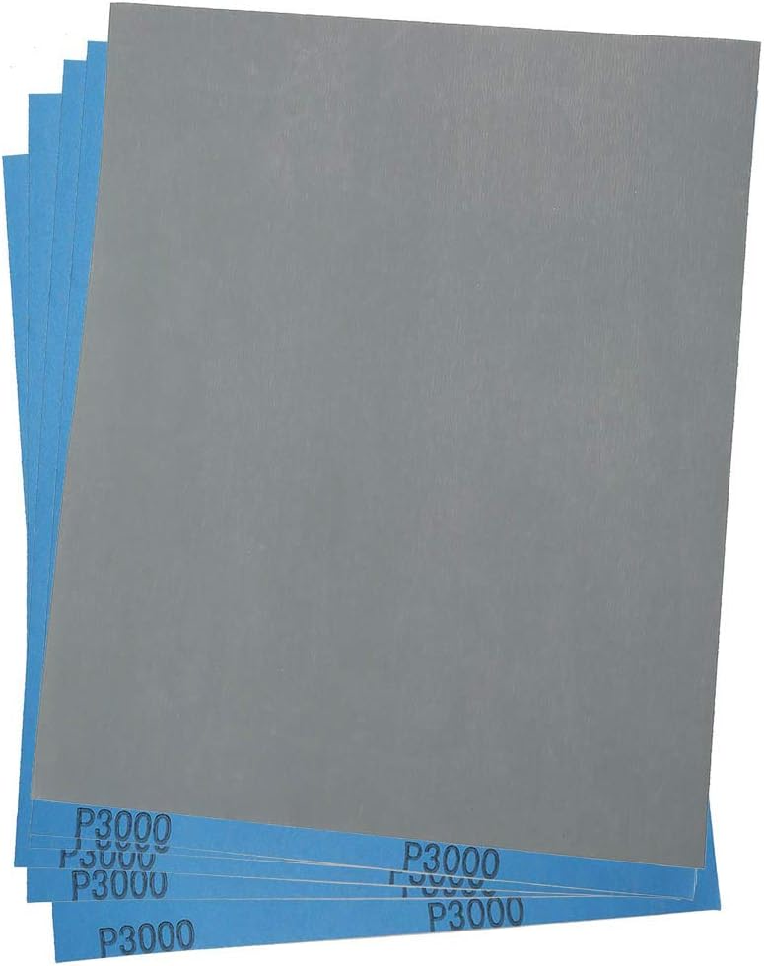
Sandpaper Sheets
400 Grit
3000 Grit
https://a.co/d/0iJmNcuY

Slide 36
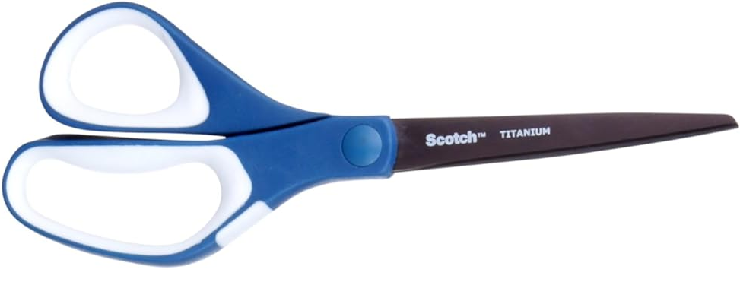
Scissors

Slide 37
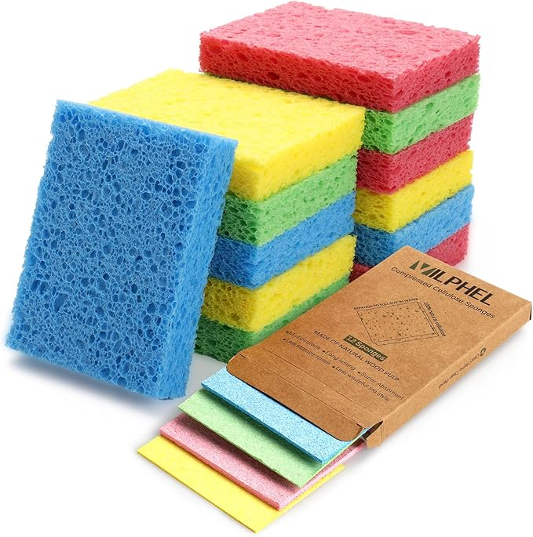
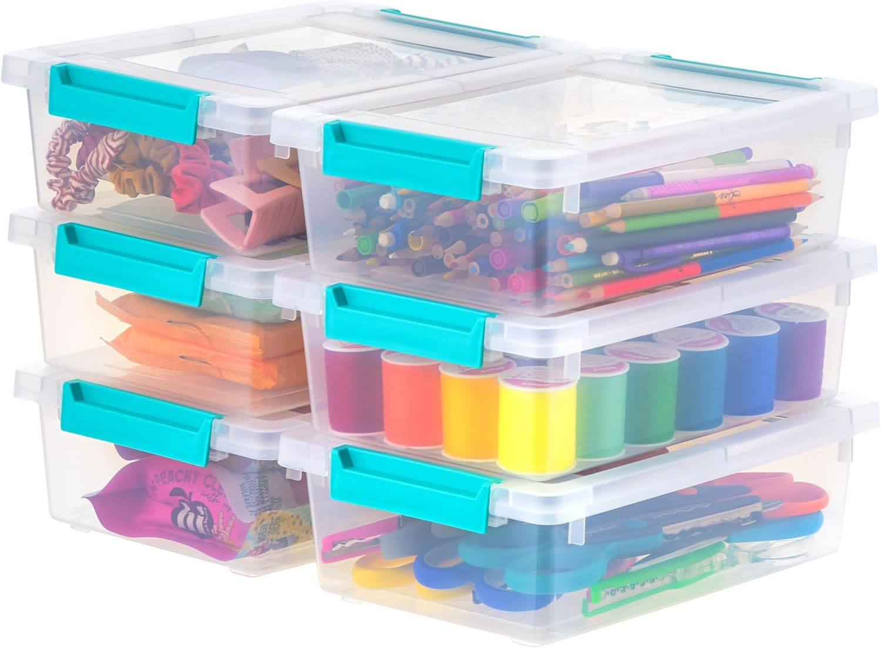
Sponge and Tupperware
https://a.co/d/0g4vZ9Un
https://a.co/d/0g4vZ9Un

Slide 38
Step 9
SADDLE SOAP THE EDGES

Slide 39
Step 9:
SADDLE SOAP THE EDGES
Materials:
None
Equipment:
None
Tools:
None
Supplies:
Sponges ($10 for 12 sponges) 1 sponge can do 50 belts
Canvas cloth ($8 for a large sheet) 1 sheet will do 1000 belts
Time:
Setup time to switch the cutting die on the tipping machine and check that the desired width is still correct
Time to cut each strap tip
Time to dispose of scrap
  Could this be used for something else?
Anything else?

Slide 40
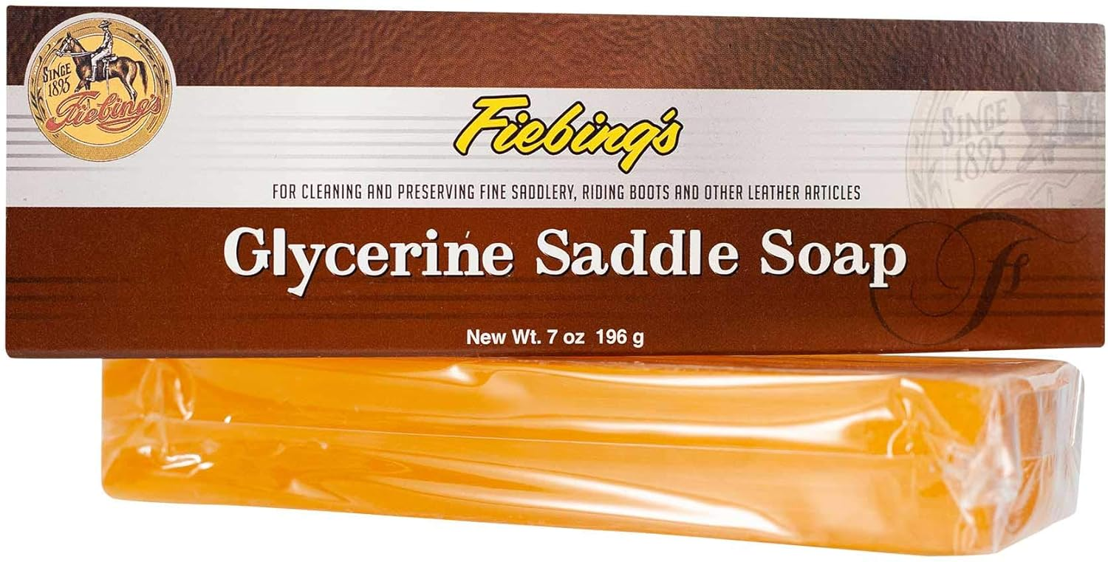
Saddle soap
https://a.co/d/0b64z9BX

Slide 41
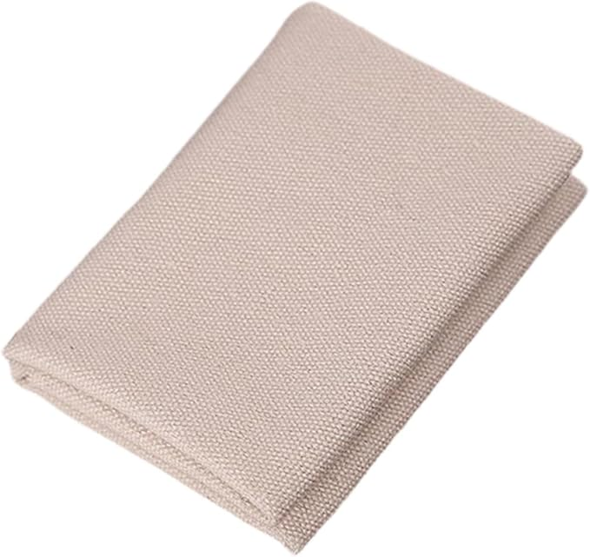
Canvas Polishing Cloth
https://a.co/d/085qwhSs

Slide 42
Step 10
MOUNT THE BUCKLE & Loop

Slide 43
Step 10:
MOUNT THE BUCKLE & Loop
Materials:
Buckle ($1.20 each) one per belt
Loop ($1.50 each) one per belt
Chicago screws (100 sets for $50) two sets per belt
Equipment:
None
Tools:
Torx Screwdriver ($11)
Supplies:
Are any supplies used?
Time:
Setup time ?
Time to get buckle and loop
Time to attached with Chicago screws
Anything else?

Slide 44
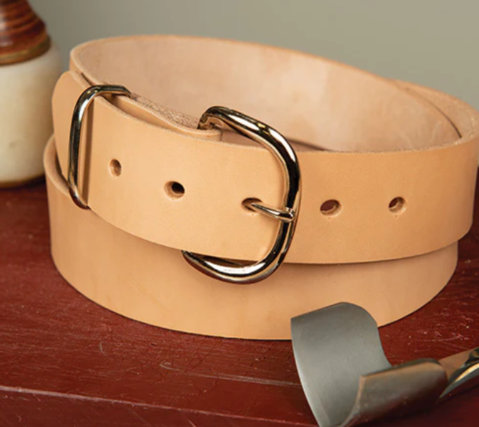
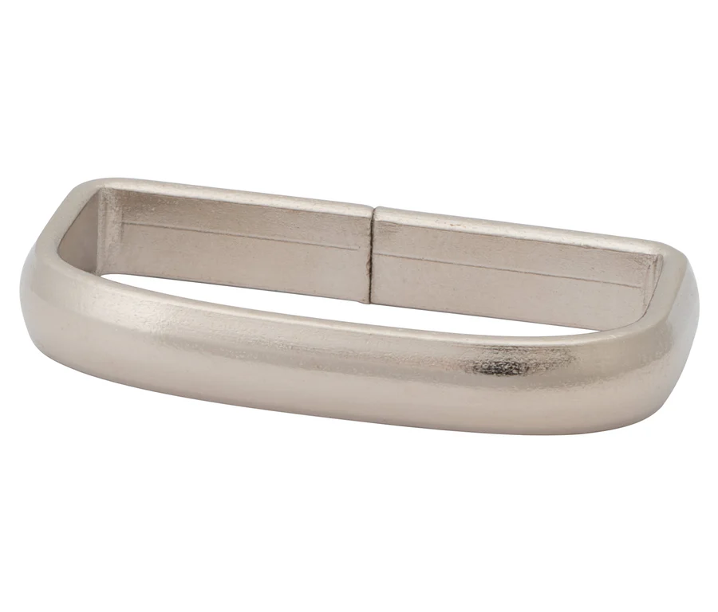
Buckle and Loop
https://www.weaverleathersupply.com/products/98-buckle-nickel-plated-1-1-2
https://www.weaverleathersupply.com/products/07395-loop?variant=40909116899468

Slide 45
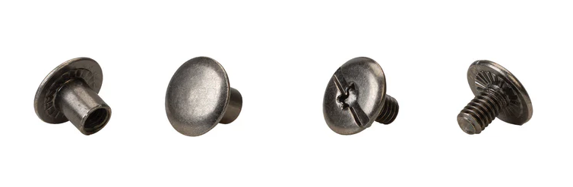
Chicago Screws
https://www.weaverleathersupply.com/products/d5038-chicago-screws?variant=40909222838412

Slide 46
Step 11
Press the Maker stamp into the leather

Slide 47
Step 11:
Press Maker stamp
Materials:
Saddle soap
Canvas cloth
Equipment:
Craftplus Pro Hand Press ($425)
Tools:
Craftplus Press Plate ($45)
Supplies:
Are any supplies used?
Time:
Setup time to get the press set to the correct position / pressure
Time to wet the leather
Time to get the stamp aligned
Time to press the stamp into the leather
Anything else?

Slide 48
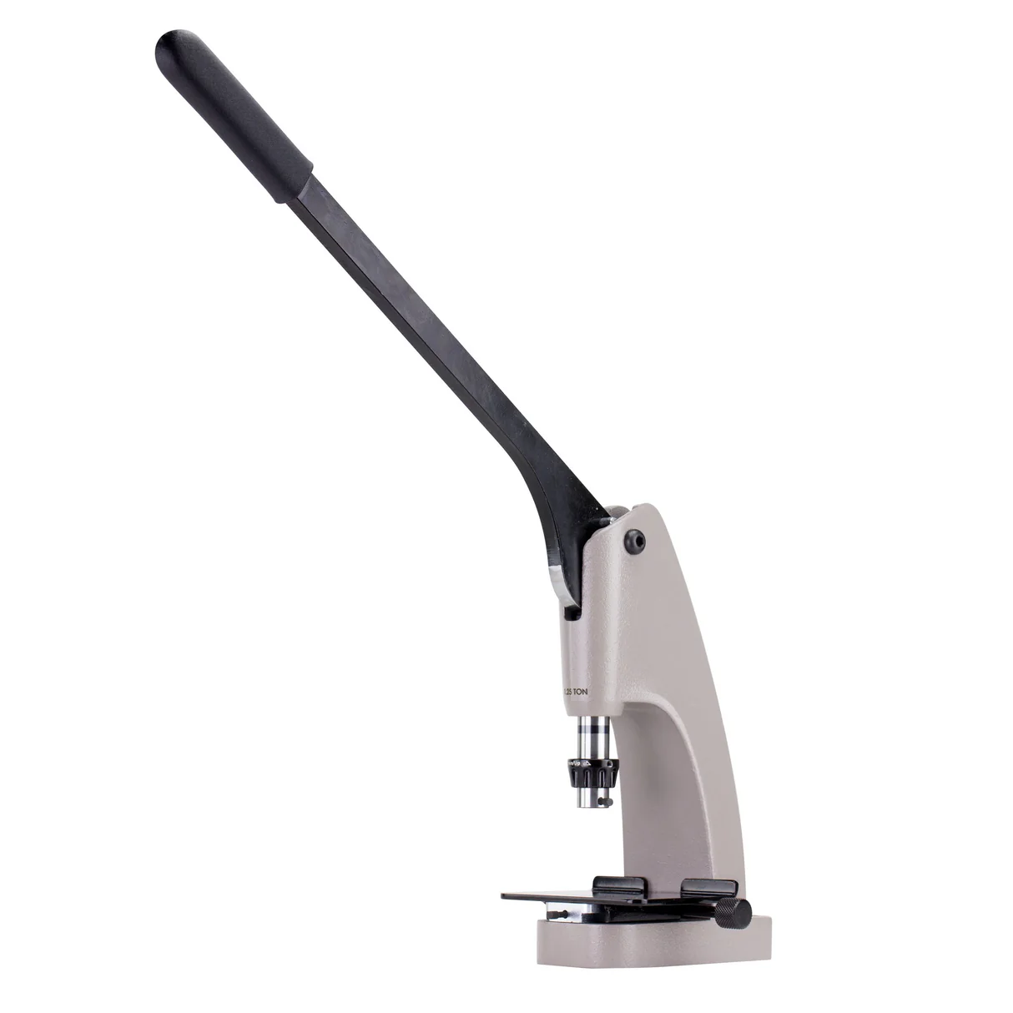
Craftplus Pro Hand Press
https://springfieldleather.com/products/craftplus-pro-hand-press

Slide 49
Step 12
Roller embossing

Slide 50
Step 11:
Roller embossing
Materials:
No new materials
Canvas cloth
Equipment:
Master Tool Creaser and Embosser ($2150)
Tools:
Embossing Roll ($270)
Did you design and make your own roller embosser? (Count this cost an time in it’s own separate step)
Supplies:
Are any supplies used? (sponge, container….)
Time:
Setup time to install the correct embossing roller
Time to run a test sample to get the correct pressure (This could be scrap leather from previous steps)
Time to wet the leather
Anything else?

Slide 51
Step 13
Package belt & deliver

Slide 52
Step 13:
Package belt & deliver
Materials:
?
Equipment:
None
Tools:
None
Supplies:
Are any supplies used?
Time:
Setup time?
Time to package
Time to deliver
Anything else?

Slide 53
Step 14
Sewing

Slide 54
Step 14:
Sewing
Materials:
?
Equipment:
Sewing Machine
Tools:
Needles?
Supplies:
Thread?
Time:
Time to setup
Change needles and thread
Anything else?

Slide 55
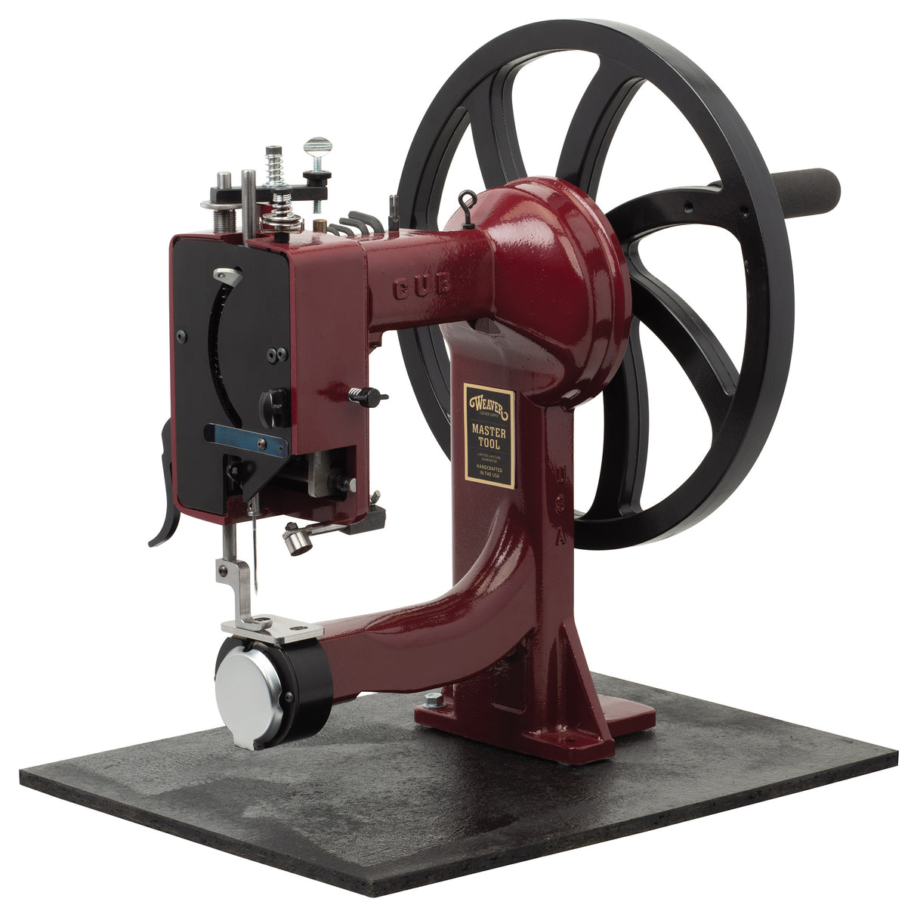
Master Tool Cub Manual Leather Sewing Machine
https://www.weaverleathersupply.com/products/master-tool-cub-manual-leather-sewing-machine-aluminum

Slide 56
Step 15
Tear down, Clean up and Reset

Slide 57
Step 15:
Tear down & Clean up
Materials:
?
Equipment:
None
Tools:
Broom?
Supplies:
Are any supplies used?
Time:
Tear down time
Time to collect and dispose of trash
Time to clean equipment
Time to clean workspace
Time to package up
Anything else?

